Slide 1
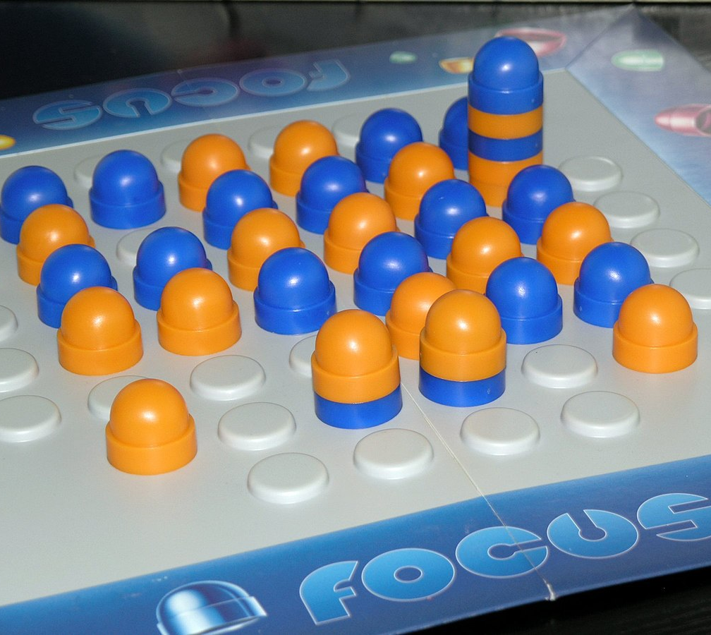

Focus 2D Game
Gonçalo Costa, up202103336
João Correia, up202005015
Ricardo Vieira, up202005091

Slide 2
2 player game on a 6×6 board with 1×4 extensions on each side. Stacks may move as many spaces as there are pieces in the stack. Players can move a stack orthogonally, and if their piece is on top of the stack. The game ends when a player doesn’t have any piece on top of any stack. Each stack, of 5 pieces maximum, when landing on another stack, merges with it. If the new stack contains more than five pieces, then pieces are removed from the bottom to bring it down to five. If a player's own piece is removed, they are kept outside the board to use later. If the piece is of the opponent, they are removed. A player doesn’t need to move the complete stack. But if he doesn’t, he must only take as many pieces of the same as positions moved.
What is focus? What are the rules?

Slide 3
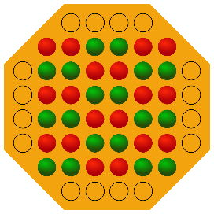
Initial State: Operators: Preconditions: Heuristics function: Moving a stack (up, down, Can move as many left or right) positions as pieces on the stack and only moves if the top piece is theirs
The number of stacks owned by the player and its size. If a player owns a stack his points will be the size of the stack times 2. For each removed piece of the opponent, the player gets more points. To the points that a player already had from the first function we add 3 times the number of pieces removed from the opponent. If a player gets the same points having one stack or two stacks it chooses the option with the most stacks.
Search problem formulation

Slide 4
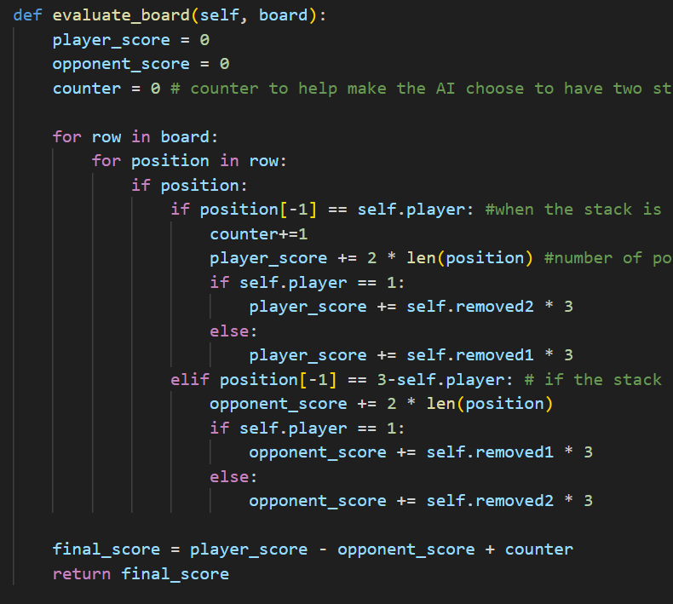
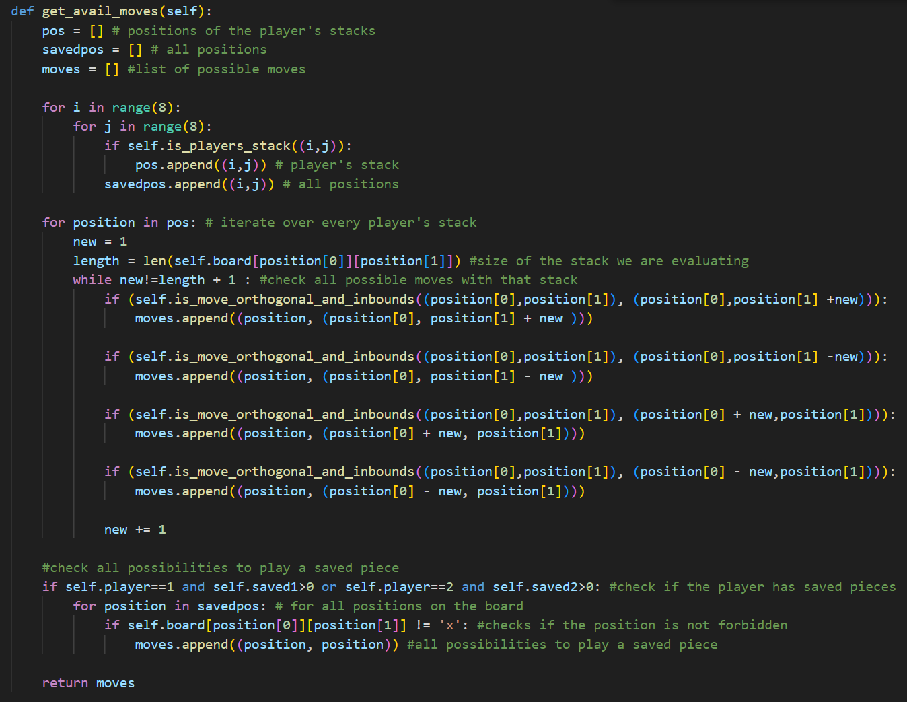
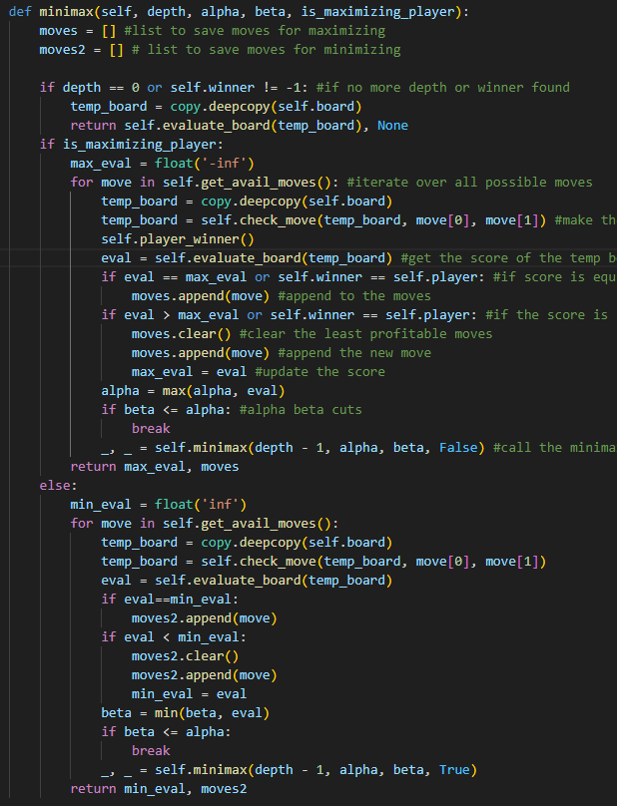
Evaluation Function: Operators: Implement Algorithm:
Calculates the final score based on the stacks owned, size of that stacks and pieces removed from the opponent.
Function that gets all possible moves of a player.
Minimax function applying Alpha-Beta cuts to calculate the best possible move of a player.
Approach

Slide 5
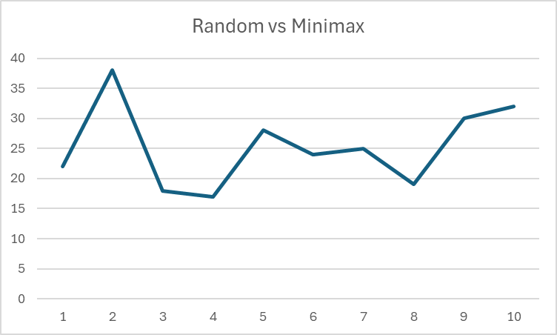
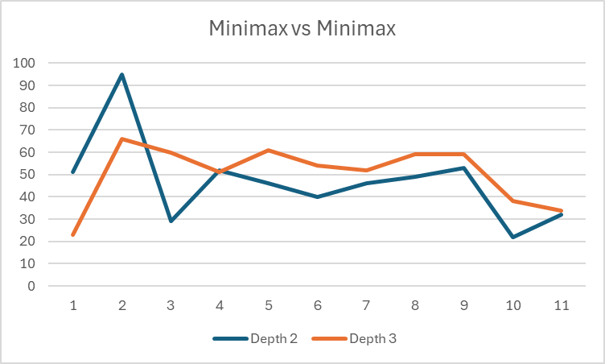
For the main minimax we used depth 8 in both approaches
Number of plays minimax took to finish the game. Average time to play: 0,02 seconds
Number of plays minimax took to finish the game. Against depth 2 won 7 times taking 0,0221 seconds to play, against depth 3 won 6 times, taking an average time of: 0,0155
Results and analysis

Slide 6
With this project, we were able to understand in a practical way how the minimax algorithm works. It was the first time for all the group elements creating an AI to play a game and we appreciated the challenge.
We had to think in a critical way in order to get the best evaluation of the board so that we could get to the best possible move.
The creation of the minimax was the hardest part, but we managed to write a functional algorithm that is able to win easily against humans and random and winning most times against another minimax with lower depths.
Another issue after we made the minimax more functional was the time it took to think. Using depths larger than two, it would take a long time. This led us to improve our algorithm using alpha-beta cuts, which made all moves almost instant.
Every element had an equal contribution to the development of the project.
Conclusions

Slide 7





Programming Language
Data structures
Data analysis
References
https://boardgamegeek.com/boardgame/789/focus
https://boardgamegeek.com/video/477999/focus/domination-focus-sid-sackson-classic-sdj-1981
https://en.wikipedia.org/wiki/Focus_(board_game)
Development Environment
Framework
References and materials used

